Slide 1
Machine Learning Clustering
By:D.Kavitha

Slide 2
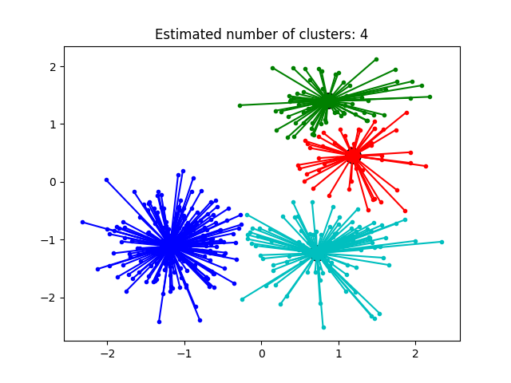
Affinity propagation
Affinity Propagation creates clusters by sending messages between data points until convergence.
A dataset is described using a small number of exemplars, ‘exemplars’ are members of the input set that are representative of clusters.
The messages sent between pairs represent the suitability for one sample to be the exemplar of the other, which is updated in response to the values from other pairs.
This updating happens iteratively until convergence, at that point the final exemplars are chosen, and hence we obtain the final clustering.

Slide 3
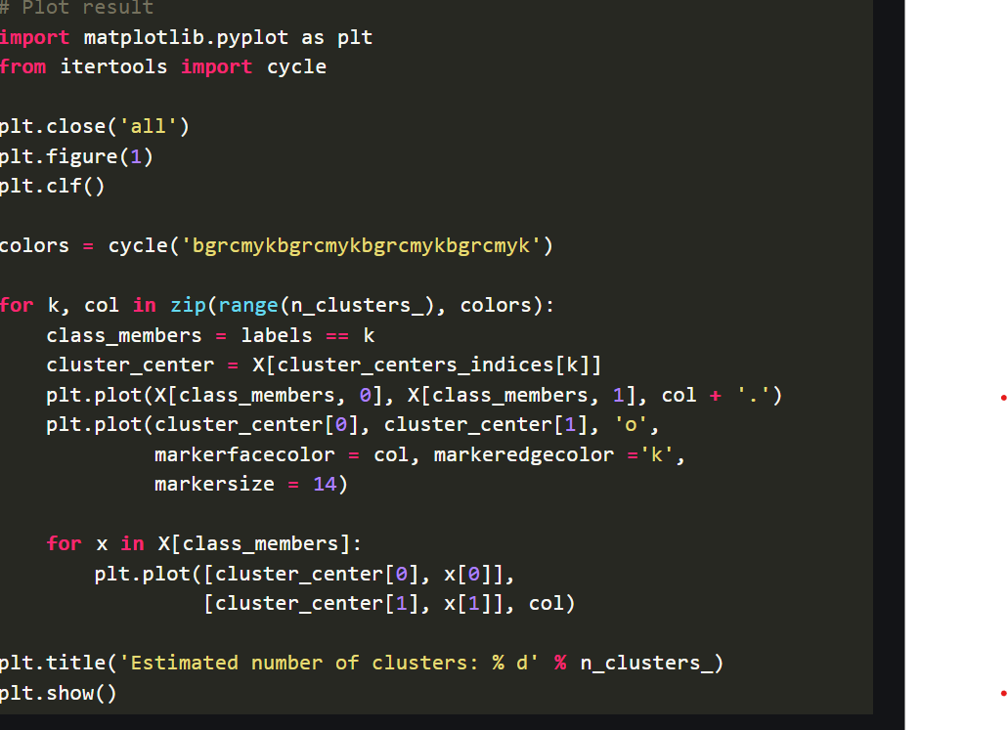
from sklearn.cluster import AffinityPropagation from sklearn import metrics from sklearn.datasets.samples_generator import make_blobs # Generate sample data centers = [[1, 1], [-1, -1], [1, -1], [-1, -1]] X, labels_true = make_blobs(n_samples = 400, centers = centers, cluster_std = 0.5, random_state = 0) # Compute Affinity Propagation af = AffinityPropagation(preference =-50).fit(X) cluster_centers_indices = af.cluster_centers_indices_ labels = af.labels_ n_clusters_ = len(cluster_centers_indices)

Slide 4
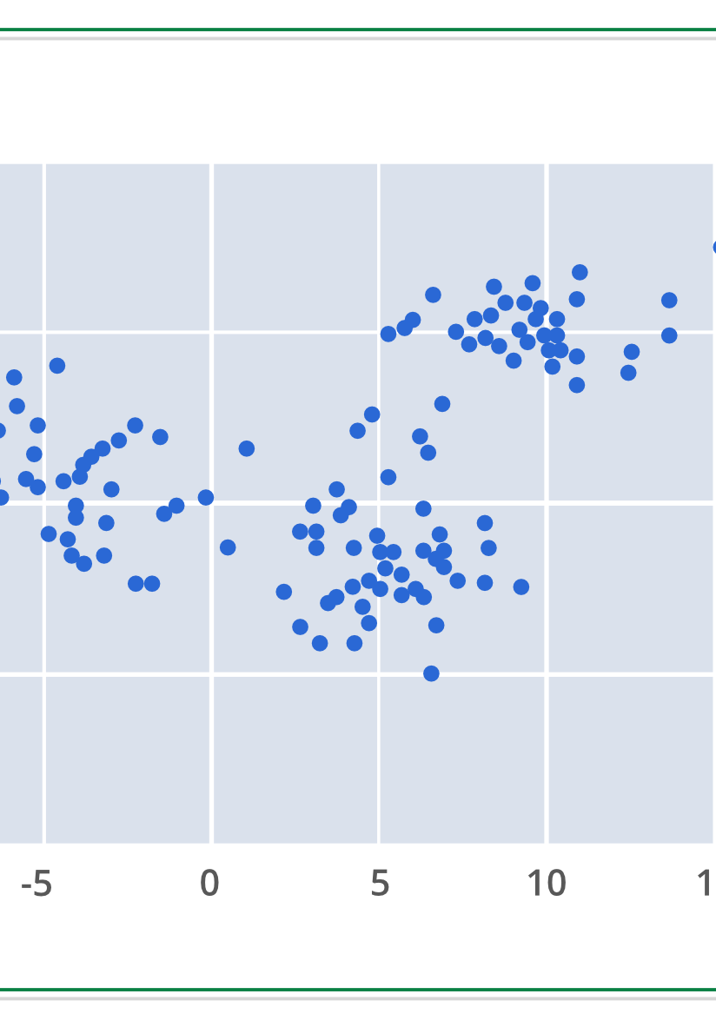
Mean Shift
Meanshift is falling under the category of a clustering algorithm in contrast of Unsupervised learning that assigns the data points to the clusters iteratively by shifting points towards the mode (mode is the highest density of data points in the region, in the context of the Meanshift).
As such, it is also known as the Mode-seeking algorithm. Mean-shift algorithm has applications in the field of image processing and computer vision.

Slide 5
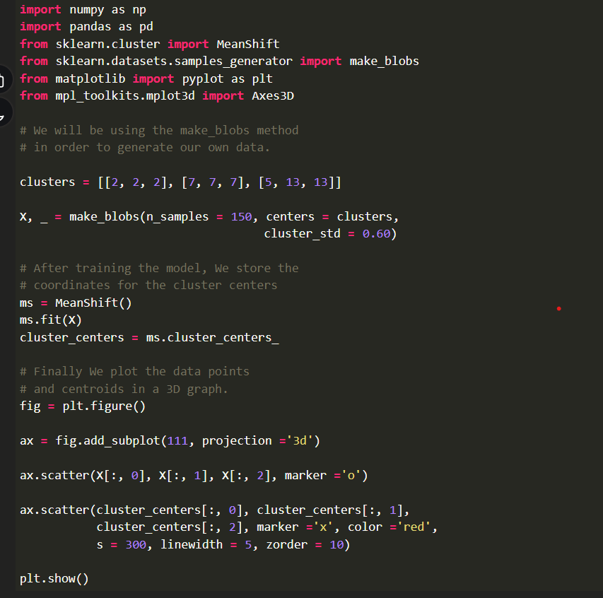
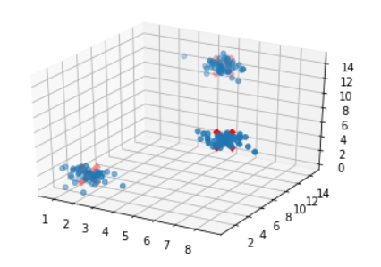

Slide 6
Mean-shift clustering is a non-parametric, density-based clustering algorithm that can be used to identify clusters in a dataset. It is particularly useful for datasets where the clusters have arbitrary shapes and are not well-separated by linear boundaries.
The basic idea behind mean-shift clustering is to shift each data point towards the mode (i.e., the highest density) of the distribution of points within a certain radius. The algorithm iteratively performs these shifts until the points converge to a local maximum of the density function. These local maxima represent the clusters in the data.

Slide 7
Spectral Clustering
Spectral Clustering
Spectral Clustering is a variant of the clustering algorithm that uses the connectivity between the data points to form the clustering. It uses eigenvalues and eigenvectors of the data matrix to forecast the data into lower dimensions space to cluster the data points. It is based on the idea of a graph representation of data where the data point are represented as nodes and the similarity between the data points are represented by an edge.
Notes:
import pandas as pd
import matplotlib.pyplot as plt
from sklearn.cluster import SpectralClustering
from sklearn.preprocessing import StandardScaler, normalize
from sklearn.decomposition import PCA
from sklearn.metrics import silhouette_scor

Slide 8
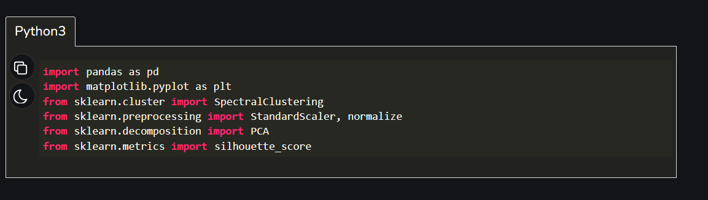
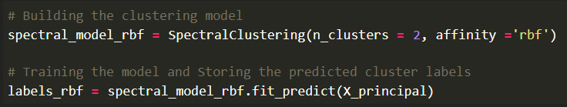
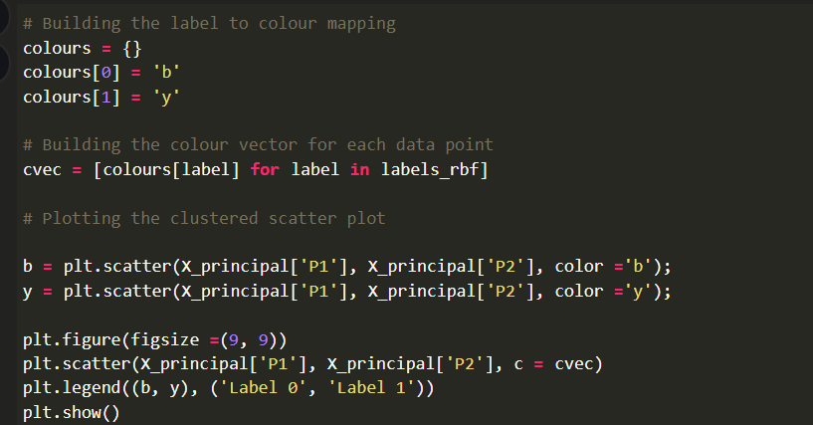
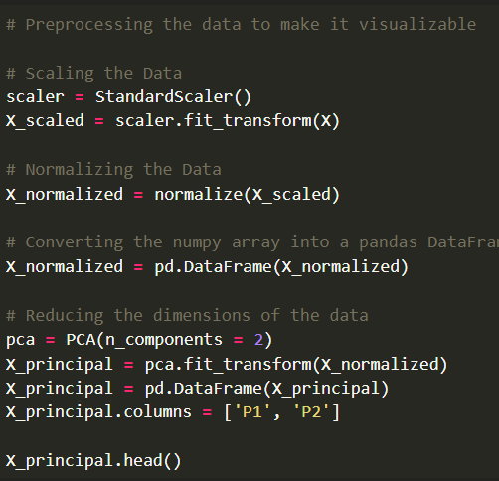
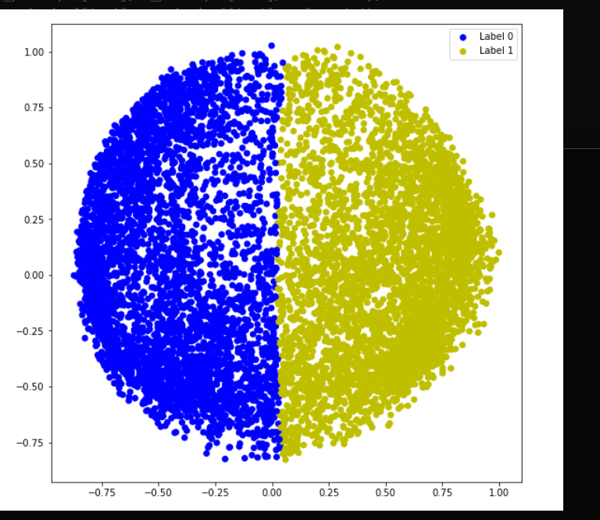

Slide 9
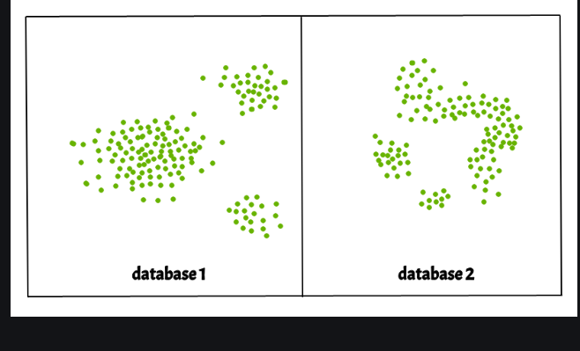
DBSCAN Clustering
Density-Based Spatial Clustering Of Applications With Noise (DBSCAN)
Clusters are dense regions in the data space, separated by regions of the lower density of points. The DBSCAN algorithm is based on this intuitive notion of “clusters” and “noise”. The key idea is that for each point of a cluster, the neighborhood of a given radius has to contain at least a minimum number of points.

Slide 10
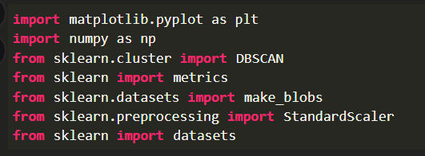
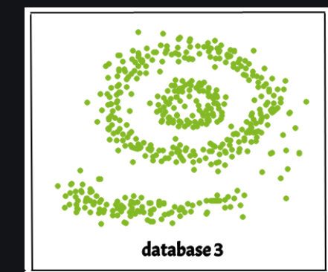
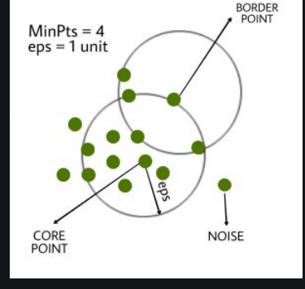


Slide 11
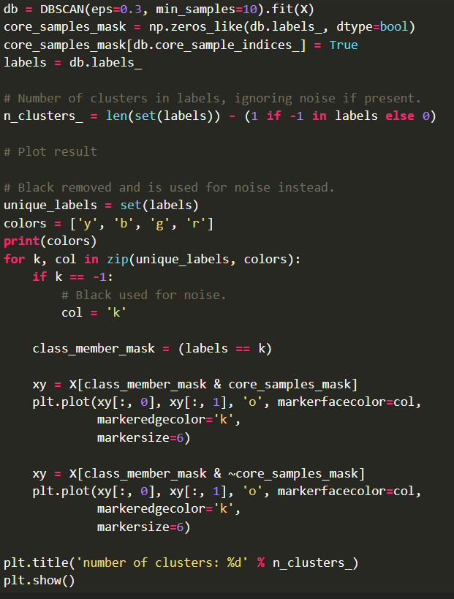
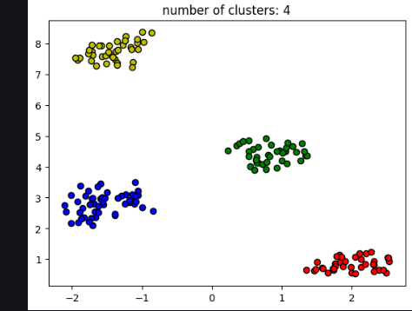

Slide 12
Thank you

